Slide 1
REQUIREMENTS DOCUMENT
This slide is to describe System Documentation (SD) Template and also Software Requirements Specification (SRS) for Plan-driven and Agile based system development

Slide 2
System Documentation SD Template Document Content
You are given a SD Template which contains
Revision page
Table of contents which have section 1-8. The description for the sections:
Section 1 – 2 : Introduction and Specific Requirements
This section represents the SRS for A2
Section 3-7: System Architectural Design until Requirements Matrix
This section represents the SDD for A3
Section 8: Test Cases
This section represents the STD for A4

Slide 3
Process to complete the System Documentation Template
When you have identified and confirm the features you want to develop from A1, you can start doing A2.
When you completed A2, submit A1 (correction) together with A2 (Section 1-2)
When you completed A3, submit A2 (1-2 update with correction) together with A3 (Section 3- 7)
When you completed A4, submit together with A2 (section 1-2), A3 (Section 3- 7 update with correction) together with A4 (Section 8)

Slide 4
SRS sections which are the same in both SRS Plan Driven and SRS Agile
Software Requirements Specification (SRS)

Slide 5
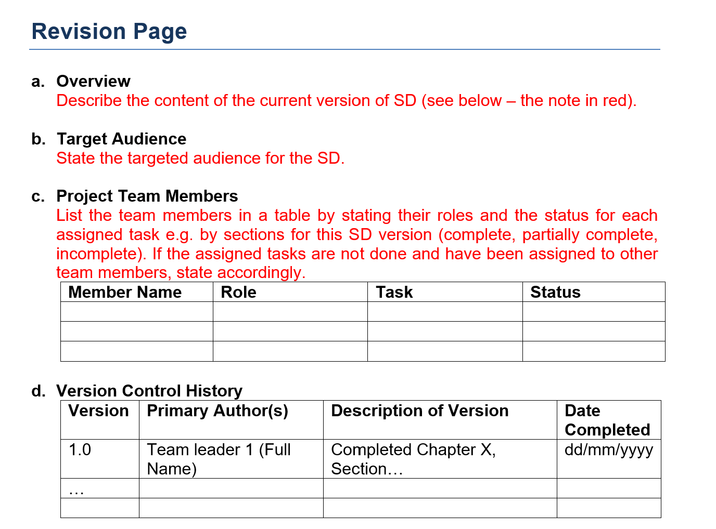
Revision Page (the same in both SRS Plan Driven and SRS Agile)
As a team you have to show
how the task are distributed
and explain truthfully which
team member who did not
participate in completing the
document
Since you completed the
system documentation
incrementally you have to
show the versions of the
document

Slide 6
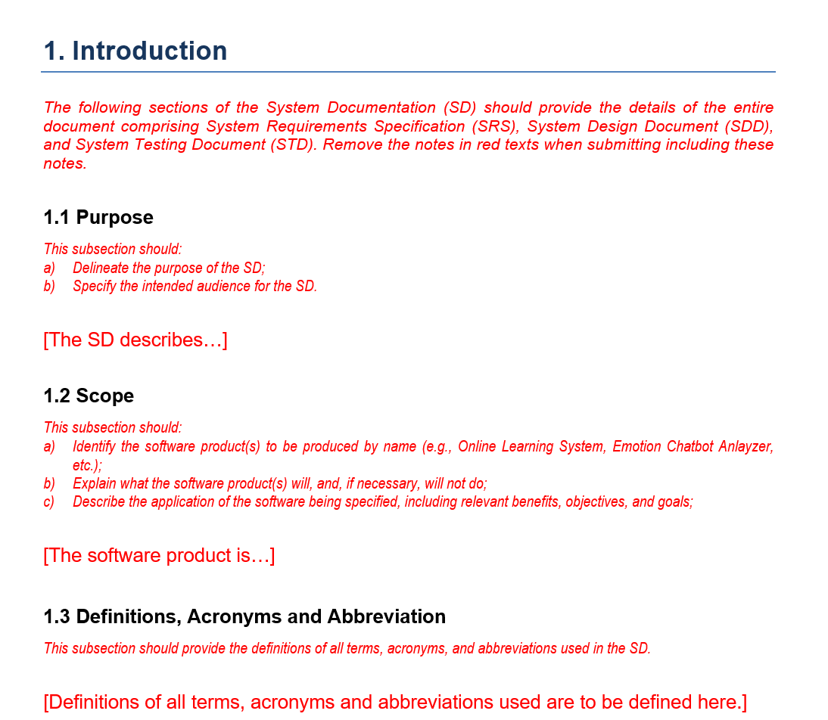
Section 1
Follow the instruction
in red to complete each
Subsections. Make sure
complete all the sections
clear and precise with a short
sentence
Make sure you indentify a
suitable acronyms from
our domain area
For example what is acronym
DASS represent for the domain of
mental health

Slide 7
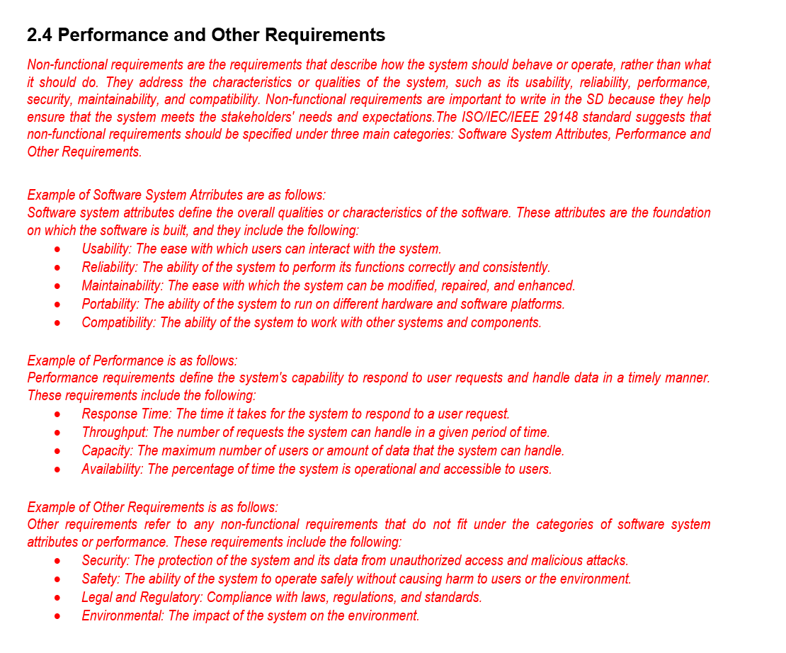
Section 2.4 Performance and Other Requirements
This section is for you to
describe your PRODUCT
non functional requirements (NFR)
Make sure you identify the MOST
SUITABLE NFR and do not choose
all the NFR because in real
implementation NFR is implemented
for the whole system and
its costly to develop

Slide 8
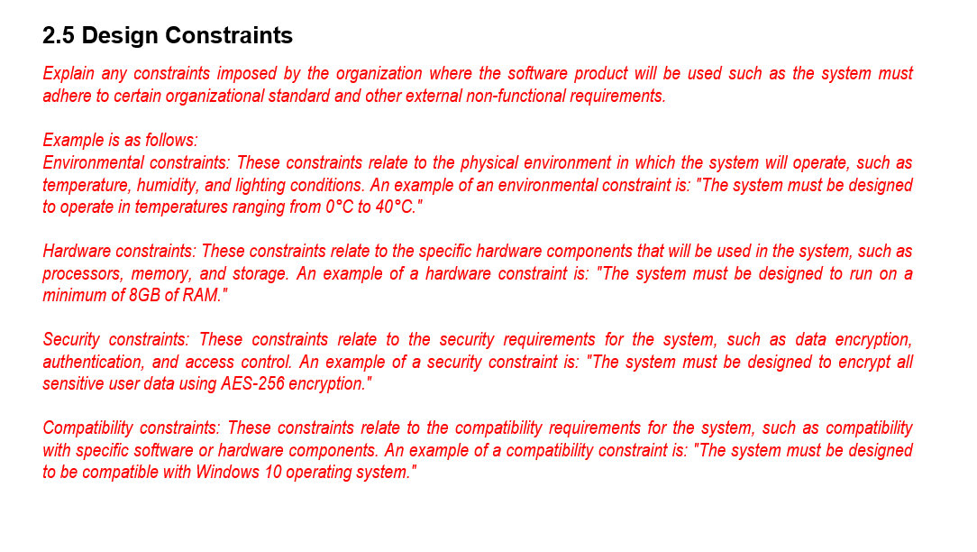
Section 2.5 Design Constraints
This section is for you to
describe your ORGANIZATIONAL
and/ or EXTERNAL non functional
requirements (NFR)

Slide 9
SRS for Plan-Driven based system development
Software Requirements Specification (SRS) Plant-Driven

Slide 10
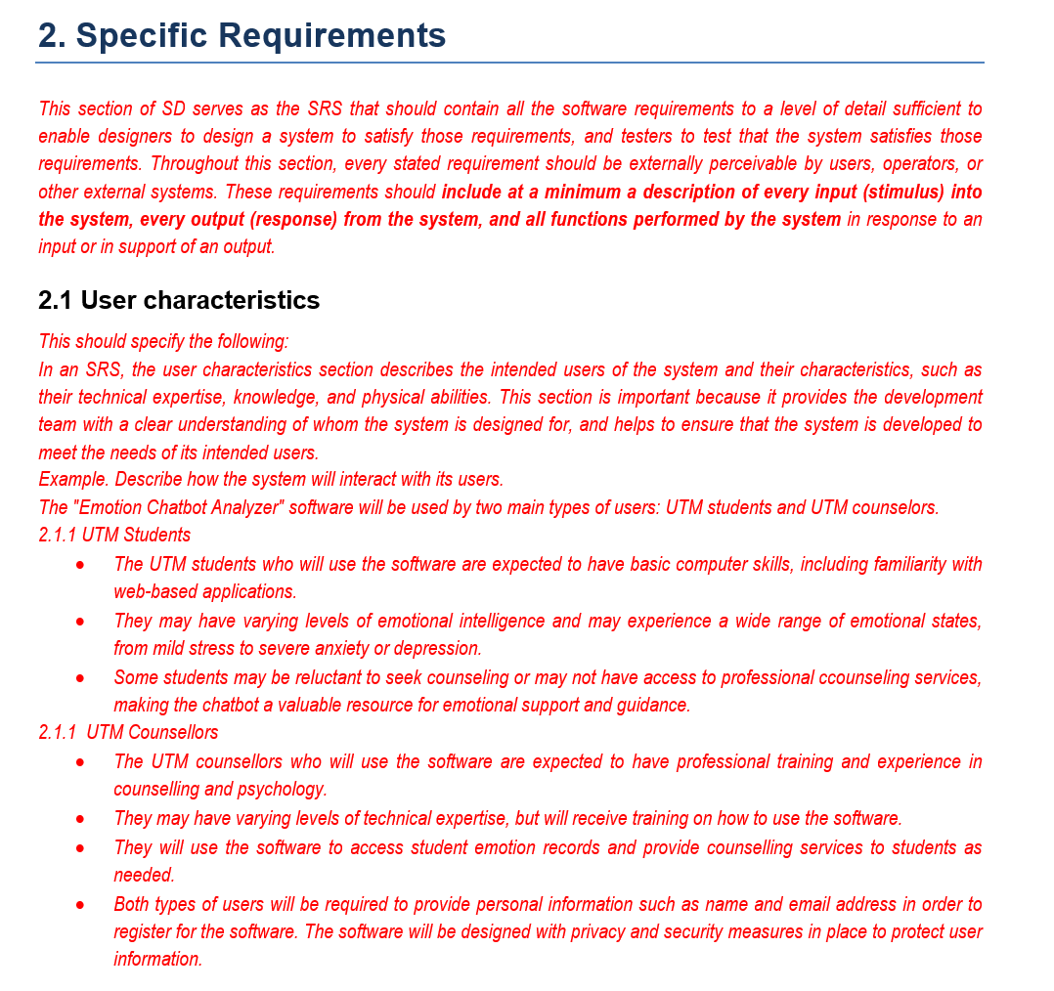
Section 2. Specific Requirements
Follow the description
given to describe user characteristics

Slide 11
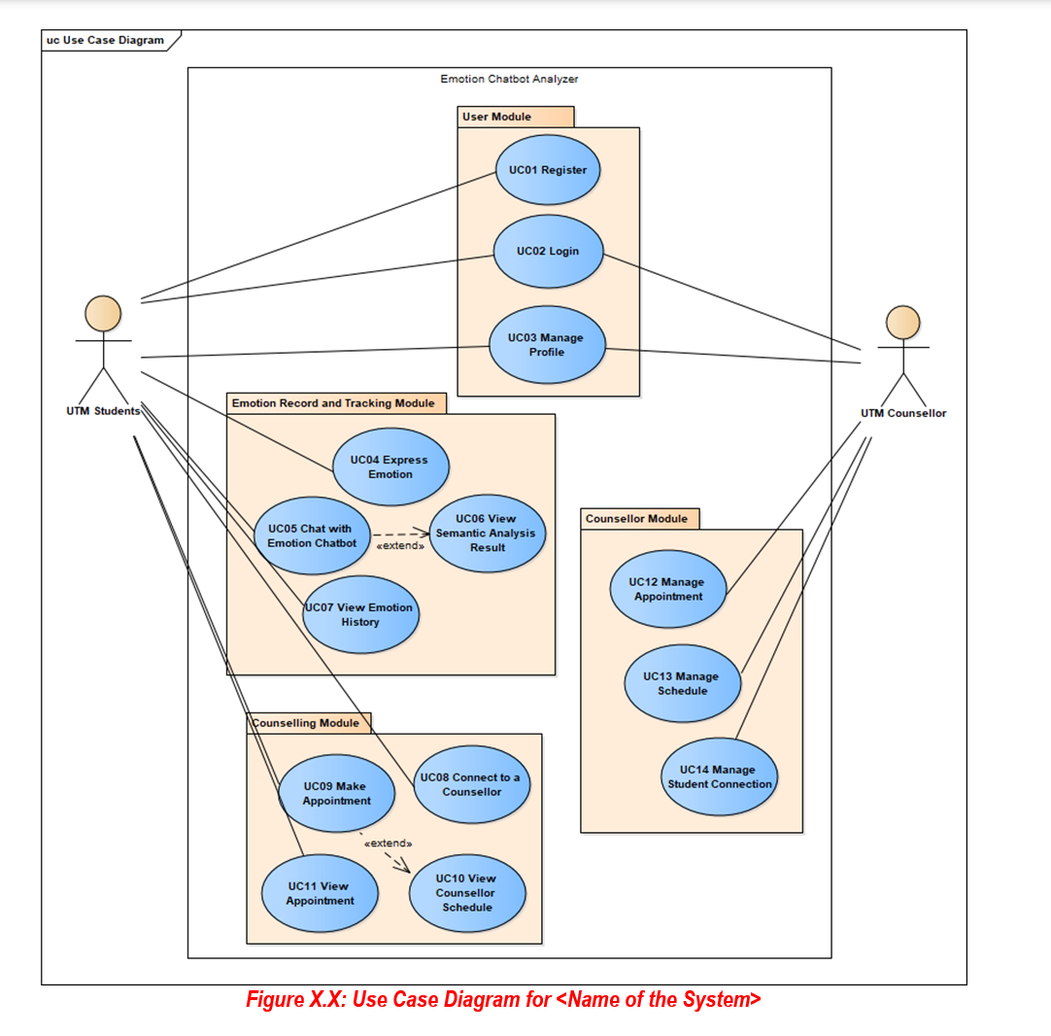
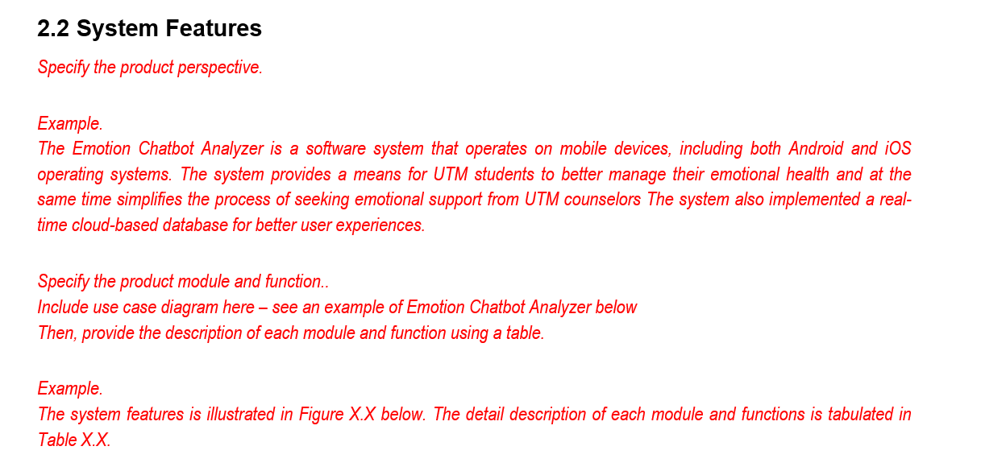
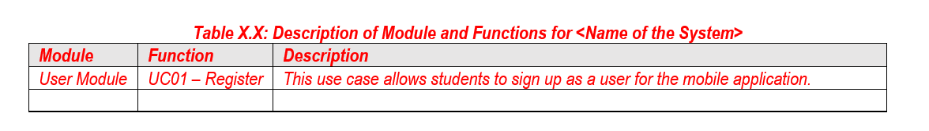
Sub-section 2.2 System Features
Grouping use case should reflect the modularity of the system for easier
implementation and maintenance. To determine which use case belongs
to which module (though this is not an absolute method):
If one use case is an extension of another use case
If use cases share a common goal or contribute to a specific functionality,
group them in one module.
- If ach module has a specific purpose and serves different actors

Slide 12
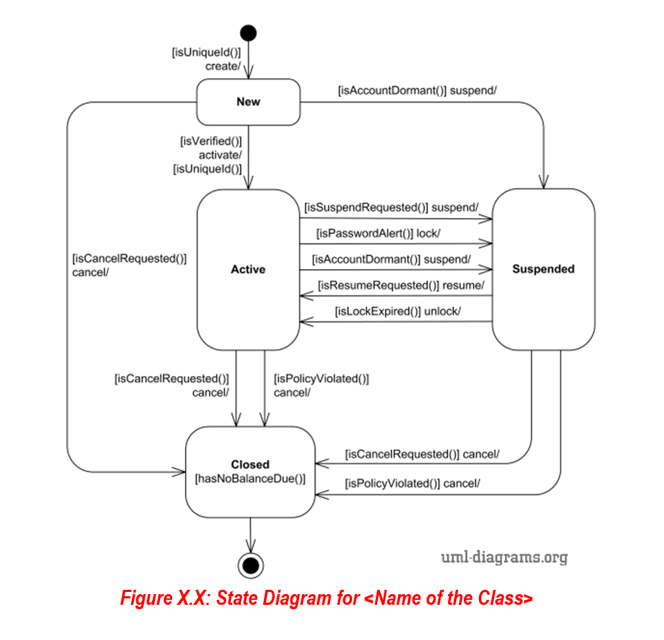
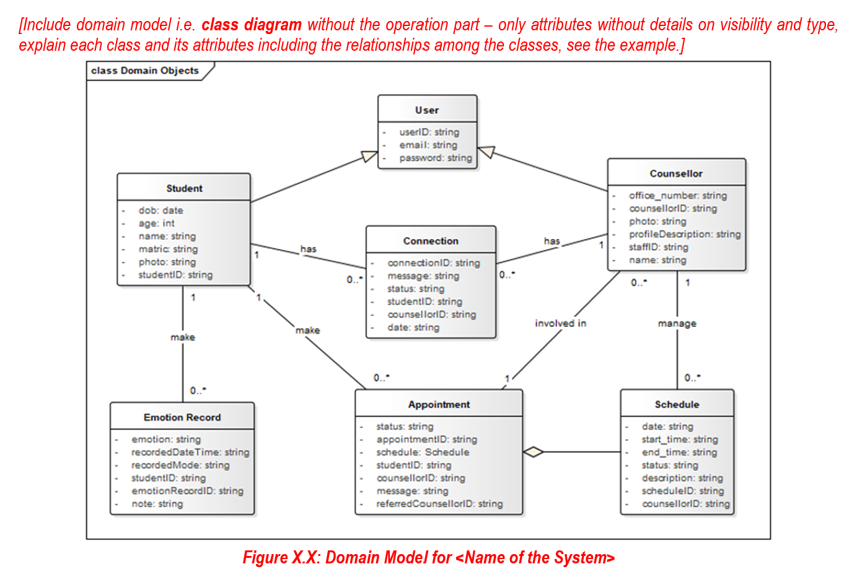
Sub-section 2.2 System Features
To create a Domain Model for your system you can do the following:
- Review system descriptions, use cases, or other documentation and extract nouns as potential candidates for classes.
To create state diagram for your system you can identify a class which is significant within the domain. It should represent an entity or process that the system needs to manage or track.

Slide 13
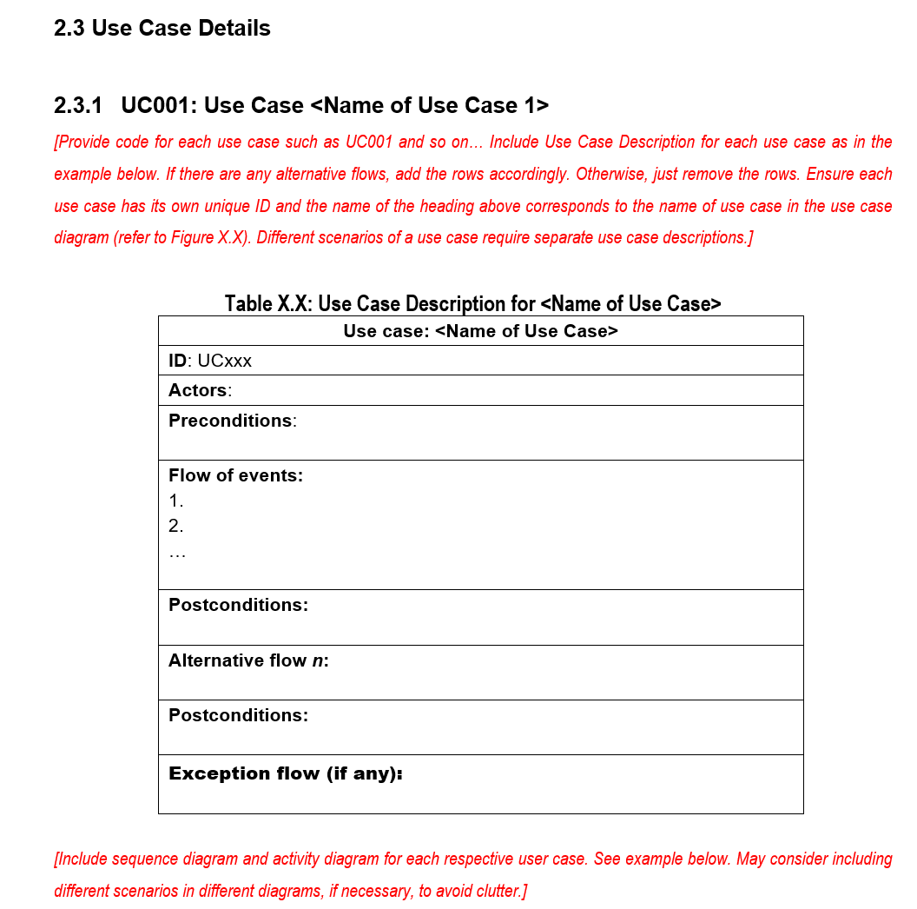
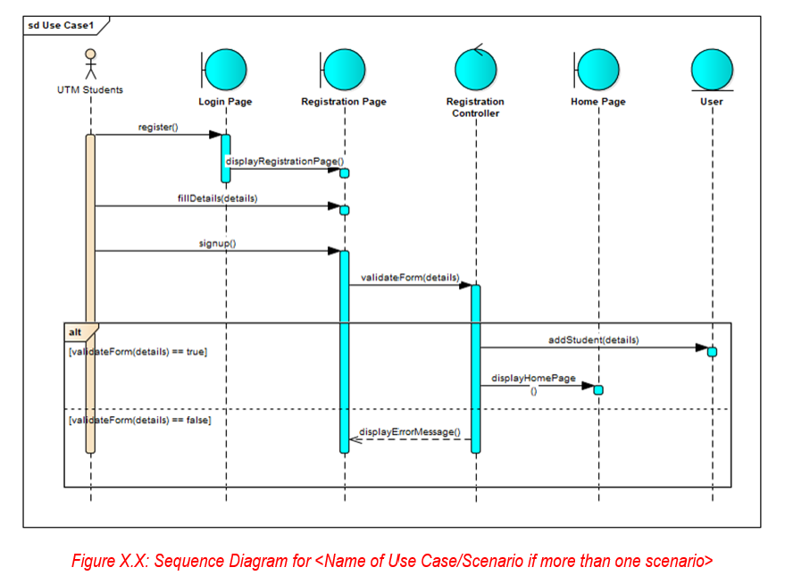
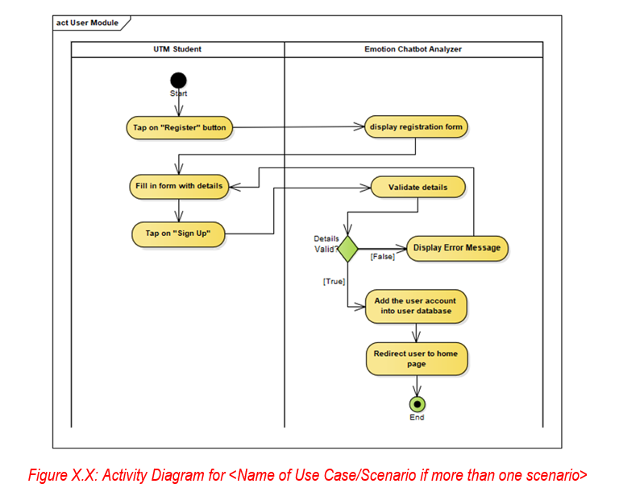
Sub-section 2.3 Use Case Details
If you have 14 use cases as shown in the Emotion Chatbot Analyzer System, you must have 14 use case descriptions (UCD) with suitable sequence diagram and activity diagram for each UCD,

Slide 14
SRS for Agile based system development
Software Requirements Specification (SRS) Agile

Slide 15
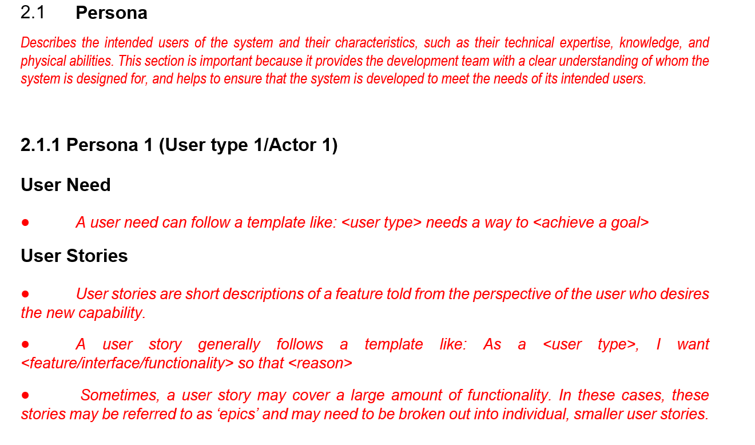
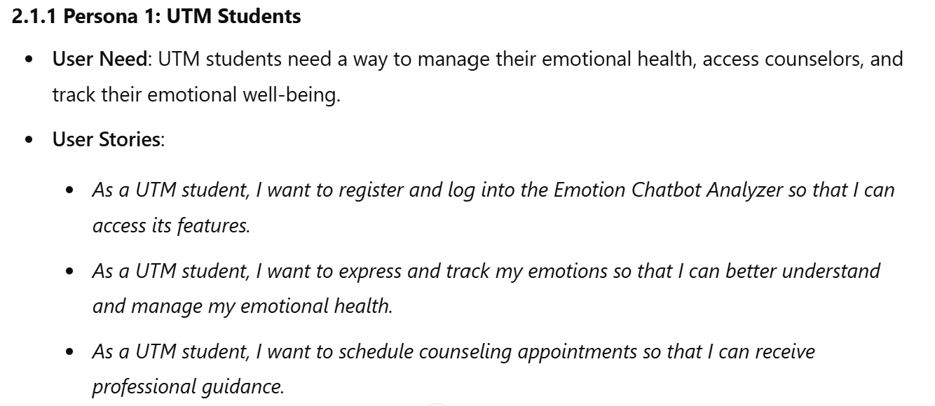
Sub-Section 2.1.1 Persona
Example of persona based on the template (following the use case diagram for Emotion Chatbot Analyzer System)
Describe persona for every user/actor for your system

Slide 16
Sub-section 2.2 System Features
Grouping use case should reflect the modularity of the system for easier
implementation and maintenance. To determine which use case belongs
to which module (though this is not an absolute method):
If one use case is an extension of another use case
If use cases share a common goal or contribute to a specific functionality,
group them in one module.
- If ach module has a specific purpose and serves different actors

Slide 17
Sub-section 2.2 System Features
To create a Domain Model for your system you can do the following:
- Review system descriptions, use cases, or other documentation and extract nouns as potential candidates for classes.
To create state diagram for your system you can identify a class which is significant within the domain. It should represent an entity or process that the system needs to manage or track.

Slide 18
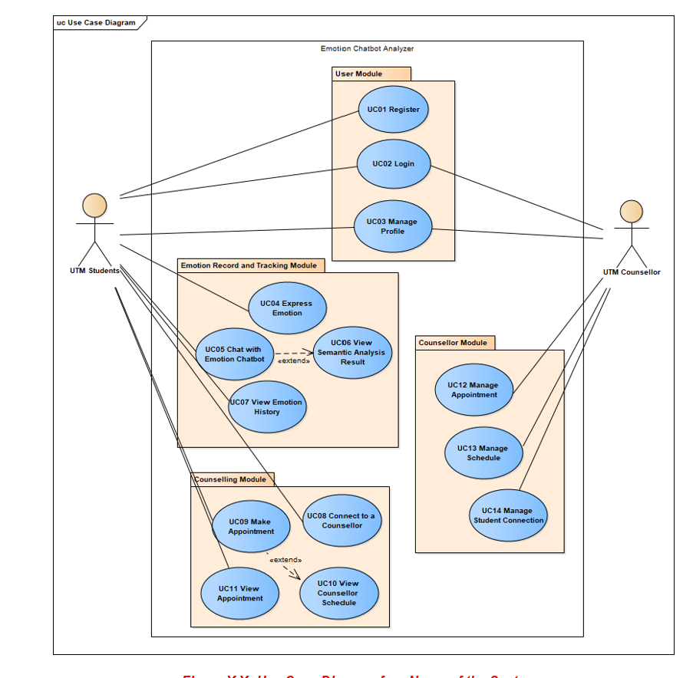
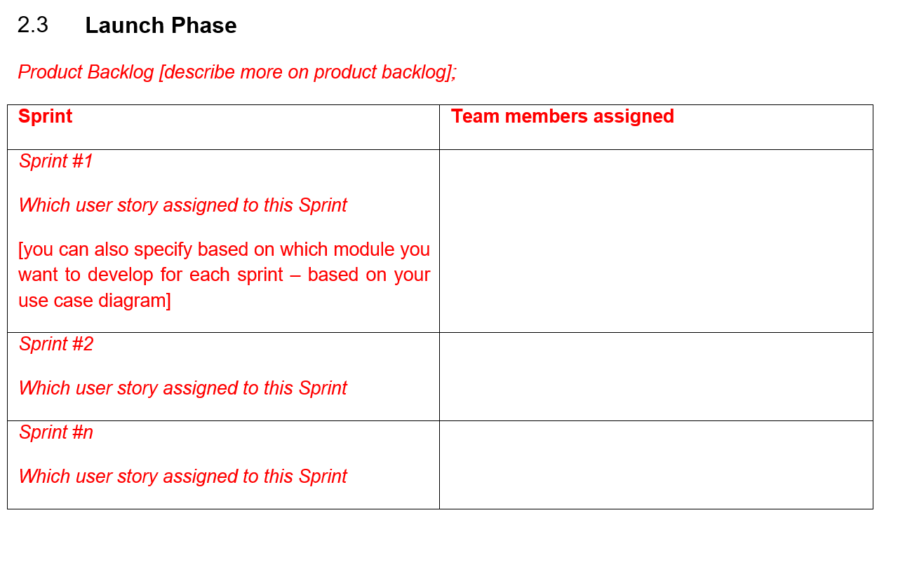
Sub-section 2.3 System Features
State who are assigned to do the sprint
You can list which user story/ module that you want to develop 1st 2 ^{st} and so forth in the product backlog

Slide 19
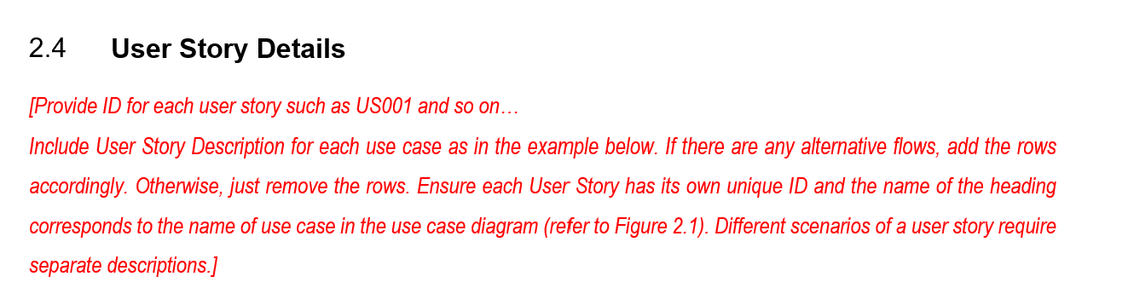
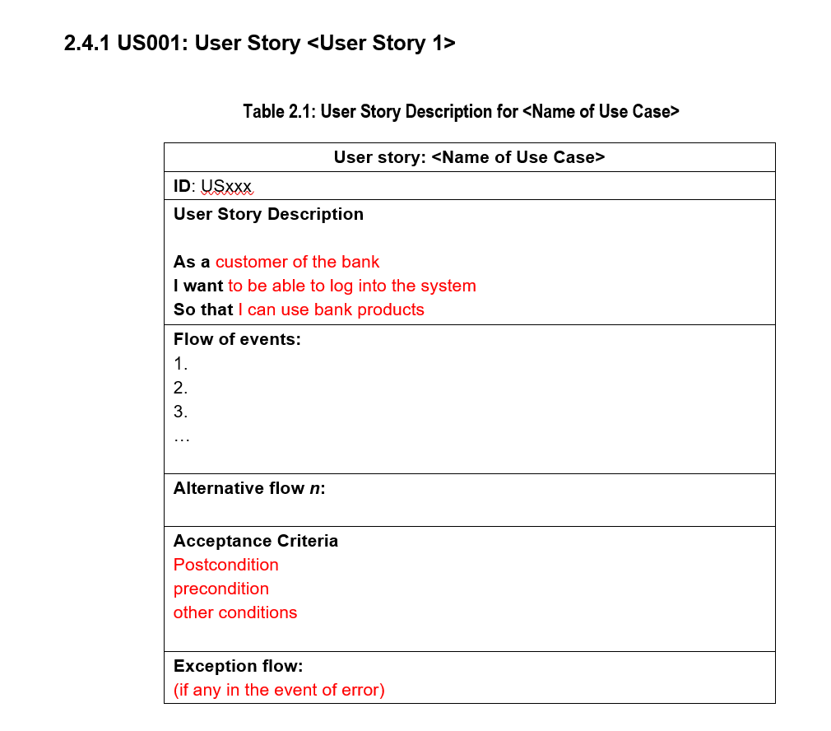
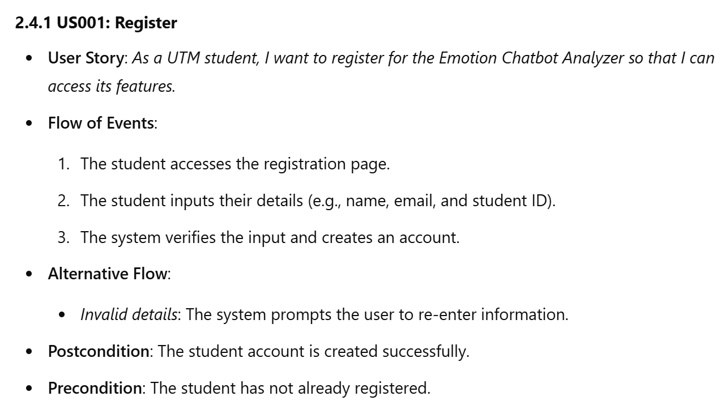
Section 2.4 User Story Details
Sample User Story based on the template
If you have 14 user story/use cases as shown in the Emotion Chatbot Analyzer System, you must have 14 User Story Details with suitable sequence diagram and activity diagram for each UCD,

